Slide 1


Slide 2
1. Web Project Overview
Clearly defining your web project's fundamental aspects is the first critical step. This section helps you articulate the core purpose, target audience, and overarching business goals, setting the stage for a successful development journey. A well-defined overview ensures all stakeholders share a common understanding and vision for the project.
Project Name:
______________________________
1
Client / Company Name:
______________________________
Date / Version:
______________________________
Project Summary:
(Brief description of the website or web application)
2
________________________________________________________________________________________________________________________________________________________________________________________________________________________________________________________________________________________________________________________________________________
Business Goals / Objectives:
________________________________________________________________________________________________________________________________________________________________________________________________________________________________________________________________________________________________________________________________________________
3
Target Audience / Users:
________________________________________________________________________________________________________________________________________________________________________________________________________________________________________________________________________________________________________________________________________________

Slide 3
2. Scope of Work
Defining a precise scope of work is paramount to avoid misunderstandings and scope creep. This section details the essential features, design requirements, and technological foundations for your project, while also clearly outlining what falls outside the project's boundaries. A clear scope minimizes risks and ensures the development team focuses on delivering exactly what you need.
Core Features / Functionalities:
Design / UI Requirements:
____________________________________________________________________________________________________________________________________________________
____________________________________________________________________________________________________________________________________________________
____________________________________________________________________________________________________________________________________________________
____________________________________________________________________________________________________________________________________________________
____________________________________________________________________________________________________________________________________________________
____________________________________________________________________________________________________________________________________________________
____________________________________________________________________________________________________________________________________________________
____________________________________________________________________________________________________________________________________________________
____________________________________________________________________________________________________________________________________________________
Platforms / Technology:
____________________________________________________________________________________________________________________________________________________
____________________________________________________________________________________________________________________________________________________
Exclusions / Limitations:
____________________________________________________________________________________________________________________________________________________
____________________________________________________________________________________________________________________________________________________

Slide 4
3. Web Development Outsourcing Timeline
A well-structured timeline is essential for project management, helping you track progress and anticipate key milestones. This section breaks down the web development process into distinct phases, providing a clear roadmap from discovery to launch. Use this to set realistic expectations and ensure timely delivery.
Phase
Start Date
End Date
Notes
Discovery
____________________
____________________
____________________________________________________________________
Design
____________________
____________________
____________________________________________________________________
Development
____________________
____________________
____________________________________________________________________
Testing
____________________
____________________
____________________________________________________________________
Launch
____________________
____________________
____________________________________________________________________

Slide 5


4. Budget / Payment Structure
Financial transparency is key to a healthy client-vendor relationship. This section helps you define the total project budget and structure payment milestones, ensuring clear financial expectations from the outset. Outlining these details in advance prevents surprises and ensures smooth financial operations throughout the project.
Total Budget:
Payment Milestones:
____________________________________________________________________
____________________________________________________________________
(e.g., Fixed Price, Time & Material, Retainer)
(e.g., upfront, on design approval, on feature completion, on launch)
Consider the payment structure carefully. Fixed-price contracts offer cost predictability but less flexibility for changes, while time & material provides adaptability but requires closer budget monitoring.

Slide 6
5. Web Development Team Roles & Responsibilities
A successful project relies on clearly defined roles and responsibilities. This section outlines the key team members involved in your outsourced web development project, specifying their contact information and primary duties. Knowing who is responsible for what fosters accountability and streamlines collaboration.
Role
Name / Contact
Responsibilities
Project Manager
____________________
____________________________________________________________________
Designer
____________________
____________________________________________________________________
Developer
____________________
____________________________________________________________________
QA / Tester
____________________
____________________________________________________________________
Other (Specify)
____________________
____________________________________________________________________

Slide 7






6. Communication Plan
Effective communication is the backbone of any successful outsourced project. This section details the preferred tools, frequency, and reporting formats for client-vendor interactions. Establishing a clear communication plan ensures timely updates, quick problem resolution, and a smooth collaborative workflow.
Frequency:
____________________________________________________________________
Reporting Format:
Tools / Channels:
____________________________________________________________________
____________________________________________________________________
(e.g., Daily Stand-ups, Weekly Progress Meetings, Bi-weekly Demos)
(e.g., Written Summaries, Dashboard Reports, Presentation Decks)
(e.g., Slack, Email, Video Calls, Project Management Software)
Regular, transparent communication builds trust and keeps everyone aligned on project goals and progress.

Slide 8
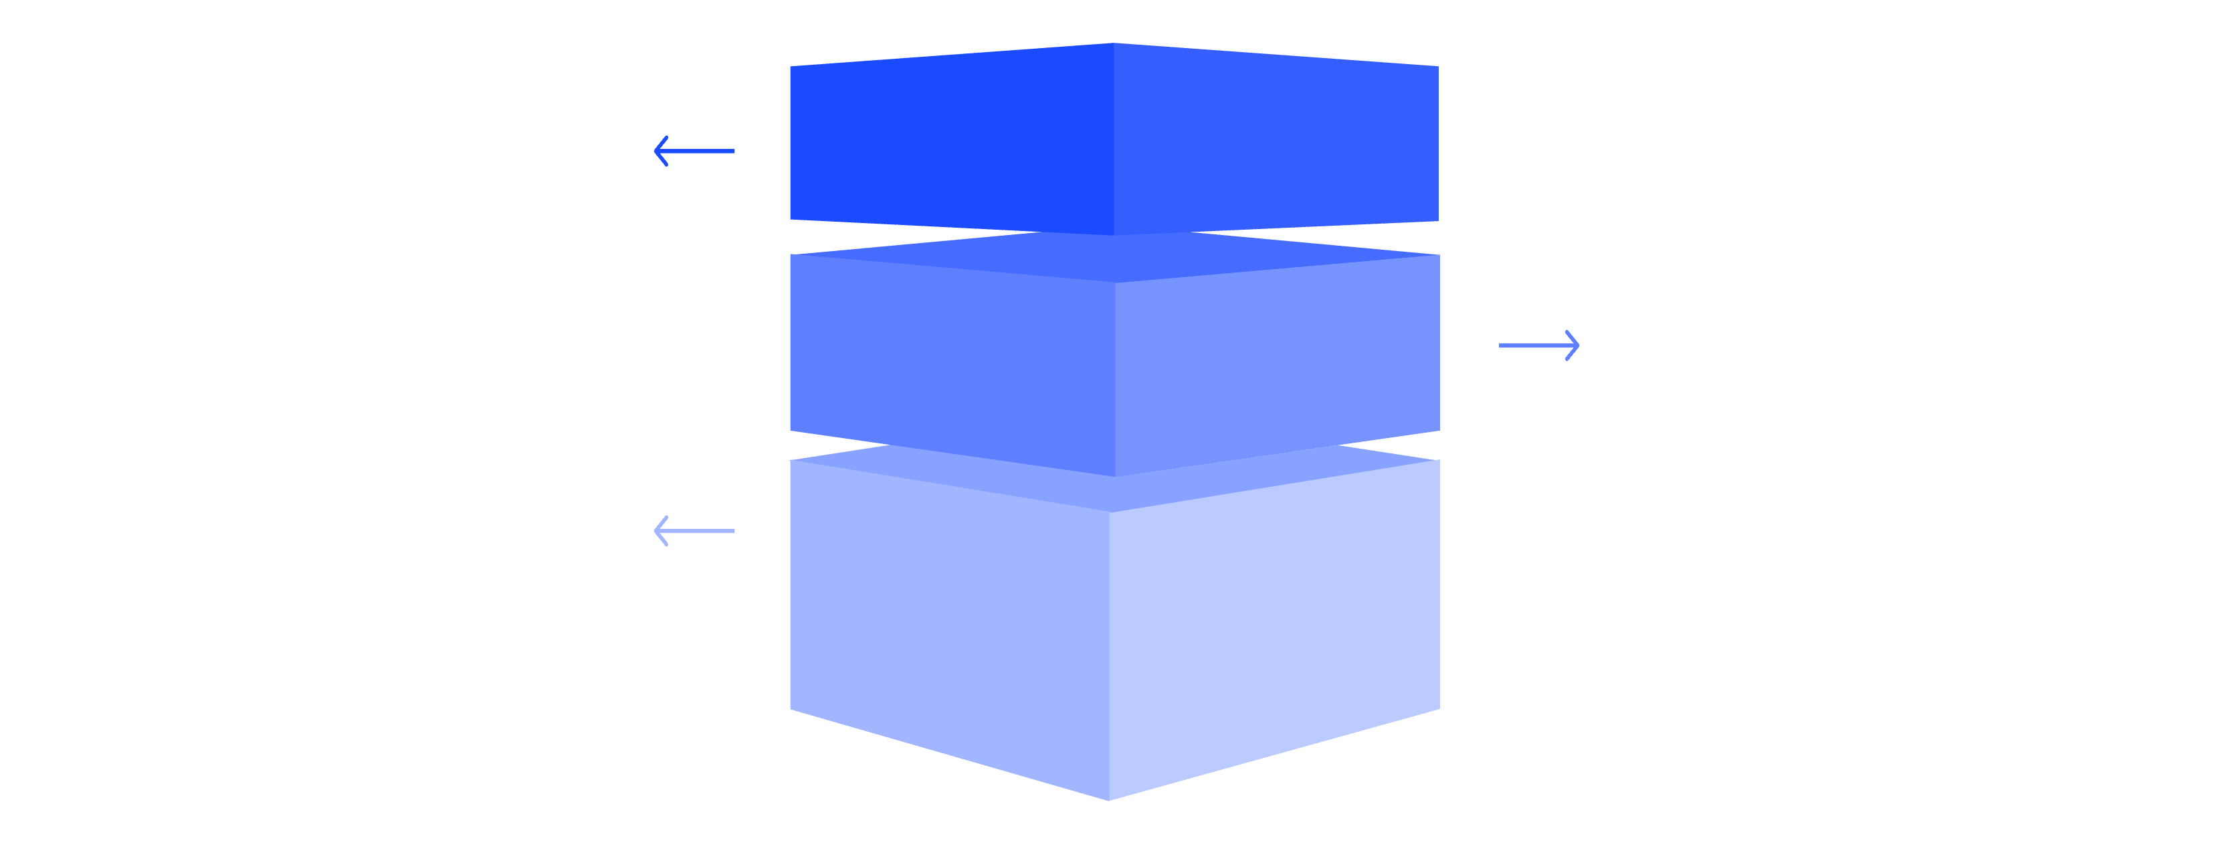
7. Quality Assurance & Testing
Ensuring the quality and functionality of your web solution is non-negotiable. This section outlines the types of testing that will be conducted and the process for tracking and resolving bugs. A robust QA strategy guarantees a polished, reliable product ready for launch.
Functional Testing
Verify features and business logic work correctly.
UI Testing
Ensure interface elements are consistent and usable.
Security Testing
Identify vulnerabilities and protect data integrity.
Test Types:
____________________________________________________________________
(e.g., Functional Testing, UI/UX Testing, Performance Testing, Security Testing, Compatibility Testing)
Bug Tracking / Resolution Process:
____________________________________________________________________
(e.g., Jira, Asana, Trello, Email — specify workflow for reporting, prioritizing, fixing, and retesting)

Slide 9
8. Post-Launch Support
The journey doesn't end at launch; ongoing support is crucial for the longevity and success of your web presence. This section details the maintenance coverage, support channels, and service level agreements (SLAs) in place for post-launch. Planning for this phase ensures your site remains secure, up-to-date, and performs optimally.
1
Maintenance Coverage:
2
Support Channels & SLA:
____________________________________________________________________
____________________________________________________________________
(e.g., CMS updates, security patches, bug fixes, content updates)
(e.g., Email, Phone, Ticketing System; response times for critical, high, medium, low issues)

Slide 10

Approval / Sign-Off
This final section serves as a formal agreement, capturing the necessary signatures to signify acceptance of the outlined plan. Once signed, this document becomes the guiding framework for your outsourced web development project, ensuring all parties are aligned and committed to its successful execution.
Client Name / Signature:
Outsourced Team Lead:
____________________________________________________________________
____________________________________________________________________
Date:
Date:
____________________________________________________________________
____________________________________________________________________
Thank you for partnering with us to bring your vision to life!

